Slide 1
Behind the scenes tours
Marketing pack
Date – May 2024

Slide 2
Contents
Behind the scenes tour overview
Slide 3
Tour programme and important information
Slide 4
Guest facing assets
Slide 5
Pre-voyage comms
Slide 6
FAQs
Slide 7
On board comms
Slide 8
Asset bank ID 1147

Slide 3
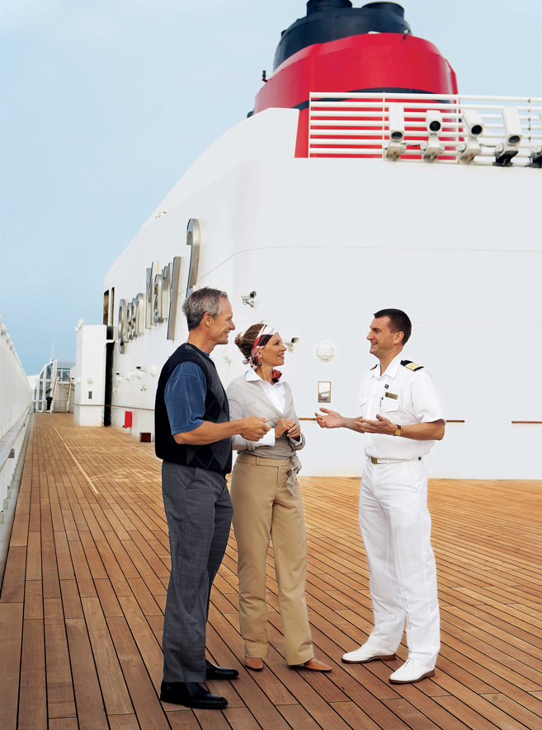
Internal use only
Behind the scenes tour – overview
The Cunard behind the scenes tour
Behind the Scenes Tours (BtS tours) present guests with an exclusive opportunity to see and experience parts of the ship usually off limits to guests. Cunard have offered BtS tours (or Back of House Tours) across the fleet both pre and post-pandemic and is now being relaunched.
What’s new?
The tour programmes have been revised, simplified and standardised ready to be rolled out across all ships. The delivery has moved from Entertainment hosted to the Shore Experiences team, and there’s an introduction of brand-new promotional collateral. The tours allow Cunard’s guests to get exclusive access to selected areas to gain insight on how Cunard deliver their iconic voyages.
Asset bank ID 1102

Slide 4
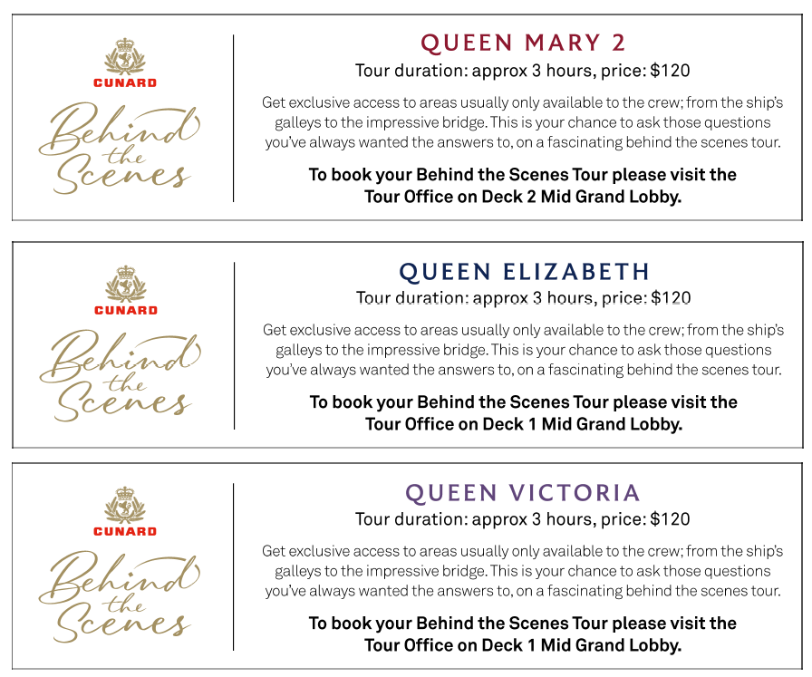
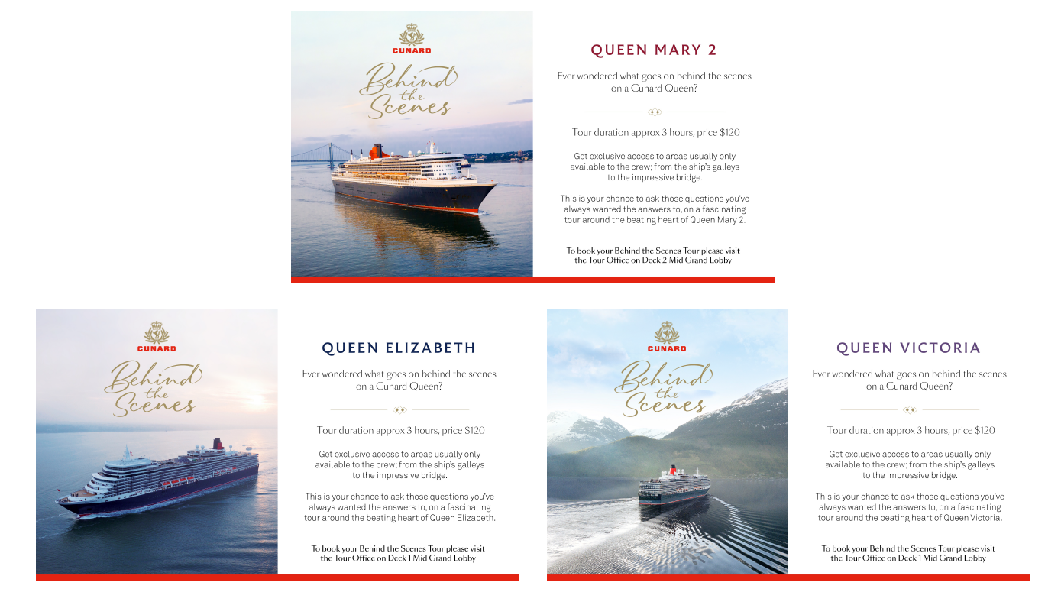
Tour programme and important information
Internal use only
What’s included in the tour?
The Shore Experiences team specific to each ship will determine the most suitable route for each tour. The tours will operate on sea days and be promoted within the Daily Programme. It will include a selection of the following locations (please only include locations from the external references in guest facing comms due to the variations across ships) :
How to book
The behind the scenes tours will be advertised in the Daily Programme and any digital signage across the ship (examples below)
Once these have been advertised, they can be booked directly at the Shore Experiences desk, where they will be shown tour descriptions and outline any participant requirements before they book, including waivers and health declarations
Guests will then receive a letter to confirm their place and advise of meeting points, dates and times
Internal reference
Theatre
ECR
Hotel Stores
Laundry
Galley
Mooring Deck
Bridge
Commodore Club
External references
Entertainment spaces
The Bridge
Galleys
Hotel areas
Technical
Navigational
Daily Programme
Digital Signage
Examples of on board collateral
Important information
This tour will take approximately 3 hours and will involve walking and standing throughout. There may be flights of stairs to negotiate as well as step-over thresholds during the tour. As you will be entering crew areas, we request that flat, closed toe footwear is worn, and flowing clothing is avoided, for health and safety purposes. This tour is not permitted for guests under 18 years of age. Phones and photography are not permitted on these tours. Attendees will be asked to complete a waiver and health declaration prior to taking the tour and pass through a security scanning arch prior to commencement. Full public health, risk assessments and HESS compliance reviews have been completed.

Slide 5
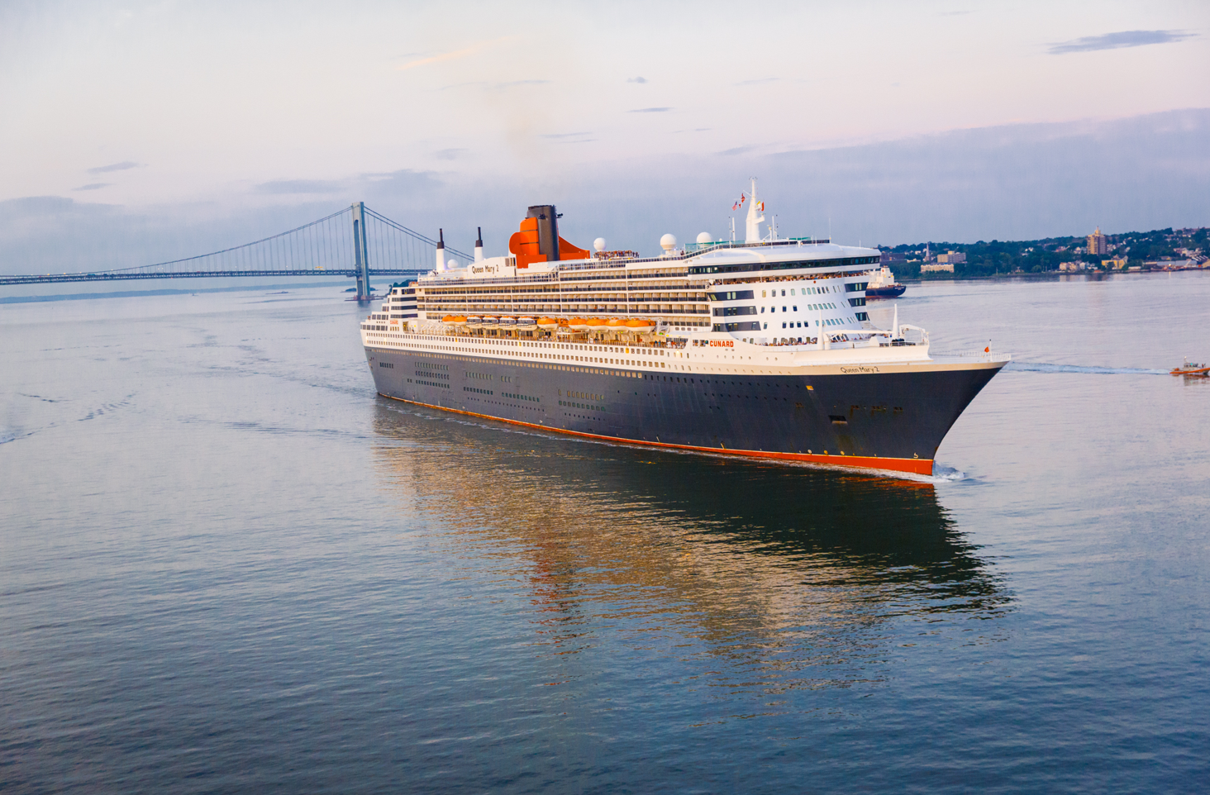
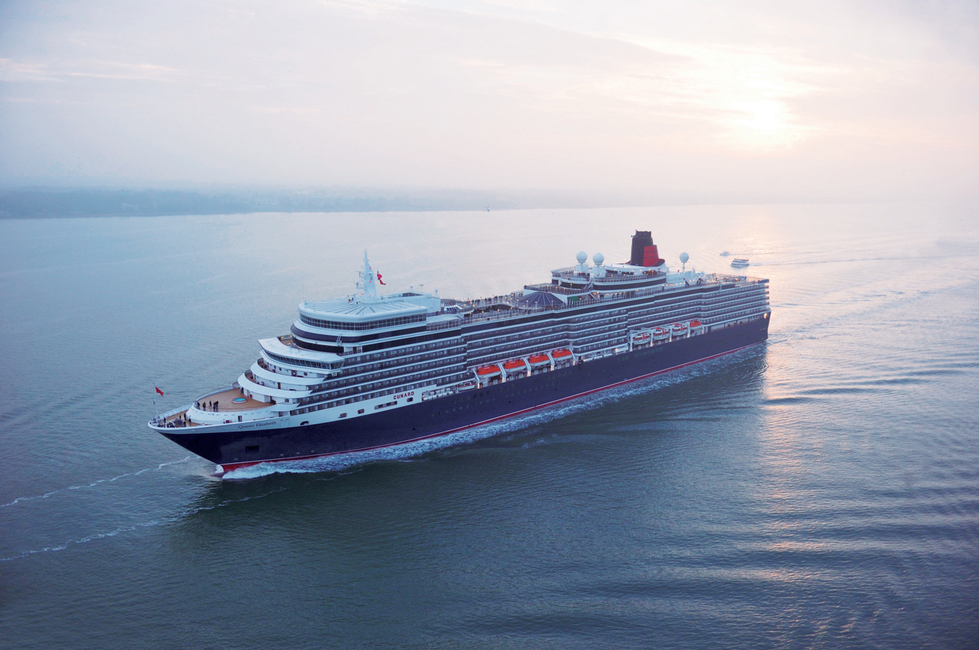
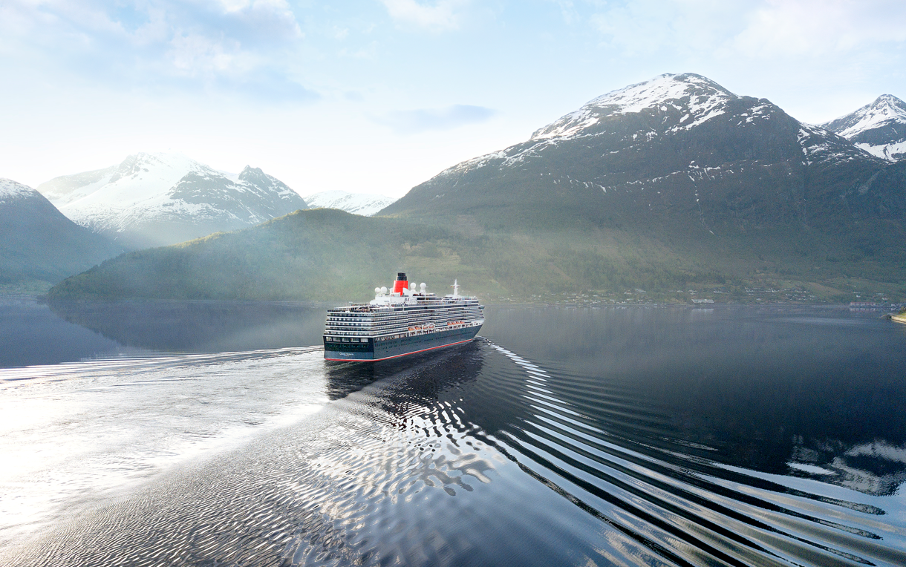
Guest facing assets
For all assets, please visit asset bank here.
Please note that all communications for the behind the scenes tours require sign off before going live. Please reach out to Kirsty Everett or Gesa Hiemcke for support in proofing and sign off by relevant stakeholders.
Guest facing hero copy:
‘Go behind the scenes’
Take a tour behind the scenes of your Cunard ship, with exclusive access to selected crew areas, and gain insight into how our incredible Queens operate.
Get exclusive access to areas usually only available to the crew on this special tour; from the ship’s galleys to the impressive bridge. This is your chance to experience a fascinating insight into the hotel, entertainment, technical and navigational operations of a working luxury cruise ship. You’ll be hosted by crew from each area who will provide an insightful tour around the beating heart on your Cunard Queen, lasting around three hours.
To check availability and to book a tour, visit the Shore Experiences team once on board.
Logo:
Imagery:
Pre approved crew imagery:
Pre approved ship imagery:
Asset bank ID 1488
Asset bank ID 1147
Asset bank ID 16020
Asset bank ID 1064
Asset bank ID 1102
Asset bank ID 2006
Please note that all other imagery requests will need to be approved before use.

Slide 6
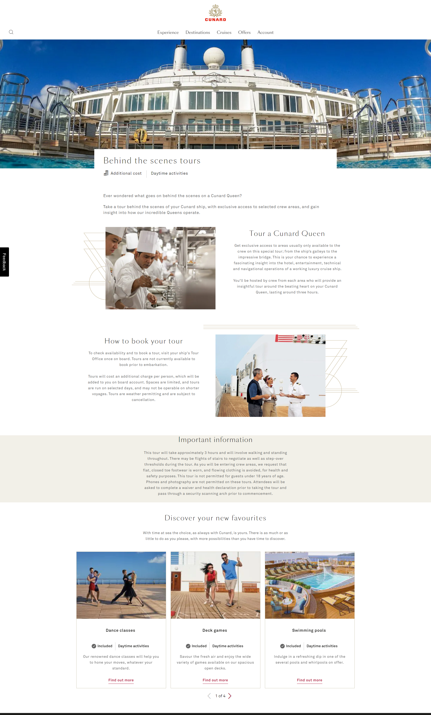
Pre-voyage comms
Website
Behind the scenes tour (cunard.com)
Ever wondered what goes on behind the scenes on a Cunard Queen? Take a tour behind the scenes of your Cunard ship, with exclusive access to selected crew areas, and gain insight into how our incredible Queens operate.
How to book your tour To check availability and to book a tour, visit your ship's Tour Office once on board. Tours are not currently available to book prior to embarkation. Tours will cost an additional charge per person, which will be added to you on board account. Spaces are limited, and tours are run on selected days, and may not be operable on shorter voyages. Tours are weather permitting and are subject to cancellation.
Tour a Cunard Queen Get exclusive access to areas usually only available to the crew on this special tour; from the ship’s galleys to the impressive bridge. This is your chance to experience a fascinating insight into the hotel, entertainment, technical and navigational operations of a working luxury cruise ship. You’ll be hosted by crew from each area who will provide an insightful tour around the beating heart on your Cunard Queen, lasting around three hours.
Important information This tour will take approximately 3 hours and will involve walking and standing throughout. There may be flights of stairs to negotiate as well as step-over thresholds during the tour. As you will be entering crew areas, we request that flat, closed toe footwear is worn, and flowing clothing is avoided, for health and safety purposes. This tour is not permitted for guests under 18 years of age. Phones and photography are not permitted on these tours. Attendees will be asked to complete a waiver and health declaration prior to taking the tour and pass through a security scanning arch prior to commencement.
Cunarder
GO BEHIND THE SCENES Take the opportunity to discover more about your favourite Cunard ships. NEW remastered Behind the Scenes tours are now available to book on board. Get exclusive access to areas usually only available to the crew, from the ships’ galleys to the impressive bridge. This is your chance to experience a fascinating insight into how our incredible Queens operate. Visit Shore Experiences on board to find out more and book your place.

Slide 7
FAQs
Does Queen Anne offer a behind-the-scenes tour?
Queen Anne does not currently offer behind-the-scenes tours, but they will be available starting mid-June.
Can I book the tour pre-cruise?
At present there is no opportunity for guests to pre-book behind the scenes tours. Options to include guest booking on My Cunard app are being continually reviewed.
How many people can join the tour and is there an age limit?
Spaces are limited with a group size to be set at minimum 6, maximum 16 and will be for over 18s only.
How much does it cost?
Prices may vary across the fleet so guests are advised to look for on board advertising of the tours for respective pricing.
When do the tours operate and how long do they take?
Tours are run on selected days and may not be operable on shorter voyages. Tours are weather permitting and are subject to cancellation. This tour will take approximately 3 hours.

Slide 8
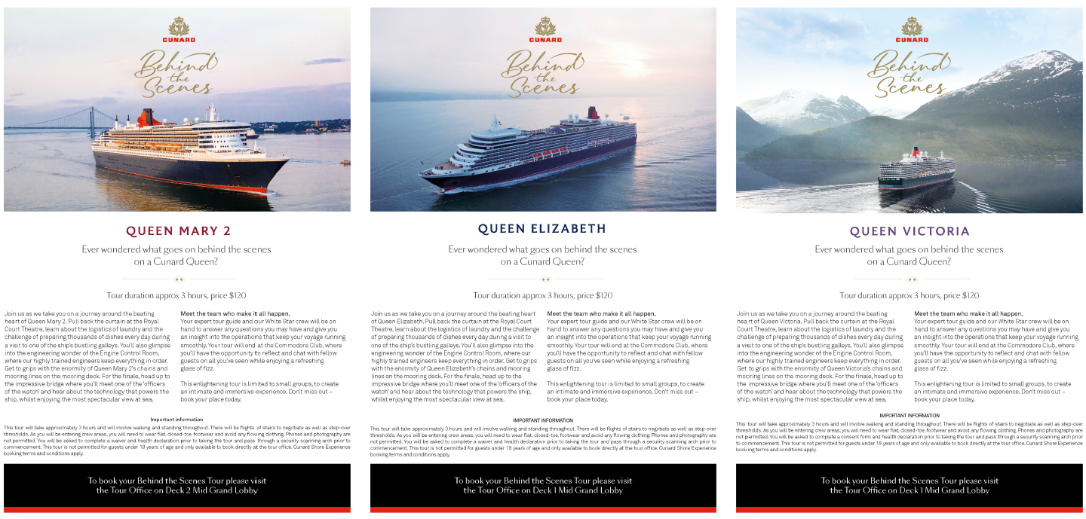
On board comms
Internal use only
If you require access to any of these on board promotional materials, please reach out to Gesa Hiemcke
Digital Signage
Daily Programme
Lanyards
Tour Description / Flyer

Slide 9
Please contact Kirsty Everett or Tracey Gillingham if you require any additional marketing assets, and Gesa Hiemcke for Shore Experience information
For all approved behind the scenes tour assets visit asset bank here: Browse Behind the scenes tour | Cunard Asset Bank (assetbank-server.com)

